Slide 1
ASP.NET Core sending e-mails

Slide 2
Table of Contents
Sending e-mail

Slide 3
MailMessage object
System.Net.Mail.MailMessage mail = new System.Net.Mail.MailMessage();
mail.To.Add("to gmail address");
mail.From = new MailAddress("from gmail address", "Email head", System.Text.Encoding.UTF8);
mail.Subject = "This mail is send from asp.net application";
mail.SubjectEncoding = System.Text.Encoding.UTF8;
mail.Body = "This is Email Body Text";
mail.BodyEncoding = System.Text.Encoding.UTF8;
mail.IsBodyHtml = true;
mail.Priority = MailPriority.High;

Slide 4
SmtpClient object
SmtpClient client = new SmtpClient();
client.Credentials = new System.Net.NetworkCredential(“gmail_address", “gmail_password");
client.Port = 587;
client.Host = "smtp.gmail.com";
client.EnableSsl = true;
try
{
client.Send(mail);
}
catch (Exception ex)
{
}

Slide 5
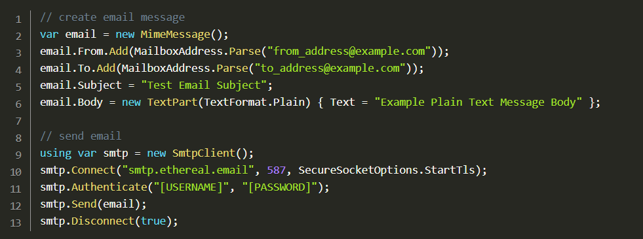
Send Emails via SMTP with MailKit
https://jasonwatmore.com/post/2020/07/15/aspnet-core-3-send-emails-via-smtp-with-mailkit

Slide 6
References
https://www.c-sharpcorner.com/UploadFile/2a6dc5/how-to-send-a-email-using-Asp-Net-C-Sharp/
https://codewithmukesh.com/blog/send-emails-with-aspnet-core/
https://ethereal.email/
https://docs.microsoft.com/en-us/dotnet/api/system.net.mail.smtpclient?view=net-5.0
https://www.infoworld.com/article/3534690/how-to-send-emails-in-aspnet-core.html
https://jasonwatmore.com/post/2020/07/15/aspnet-core-3-send-emails-via-smtp-with-mailkit

